Slide 1
PEP Input Class
Presented By
Kanika Sharma

Slide 2
Topics to be covered…
while,
do while,
for loop,
nested loops,
break,
continue

Slide 3
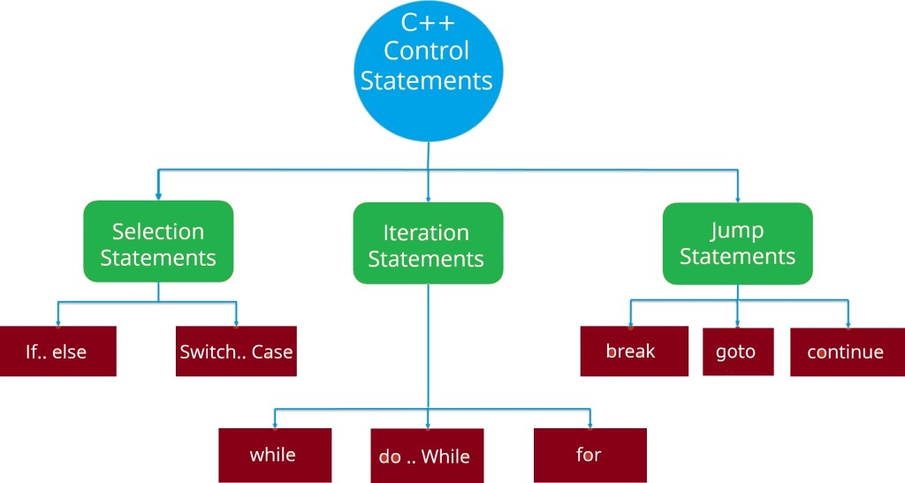
Control flow statements
Ladder if
Nested if

Slide 4
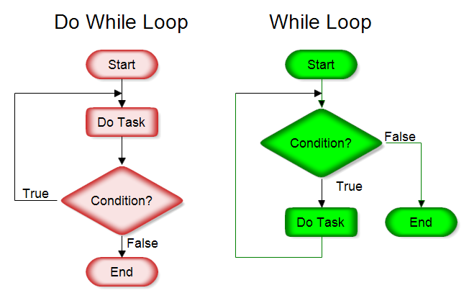
Do while vs. while loop

Slide 5
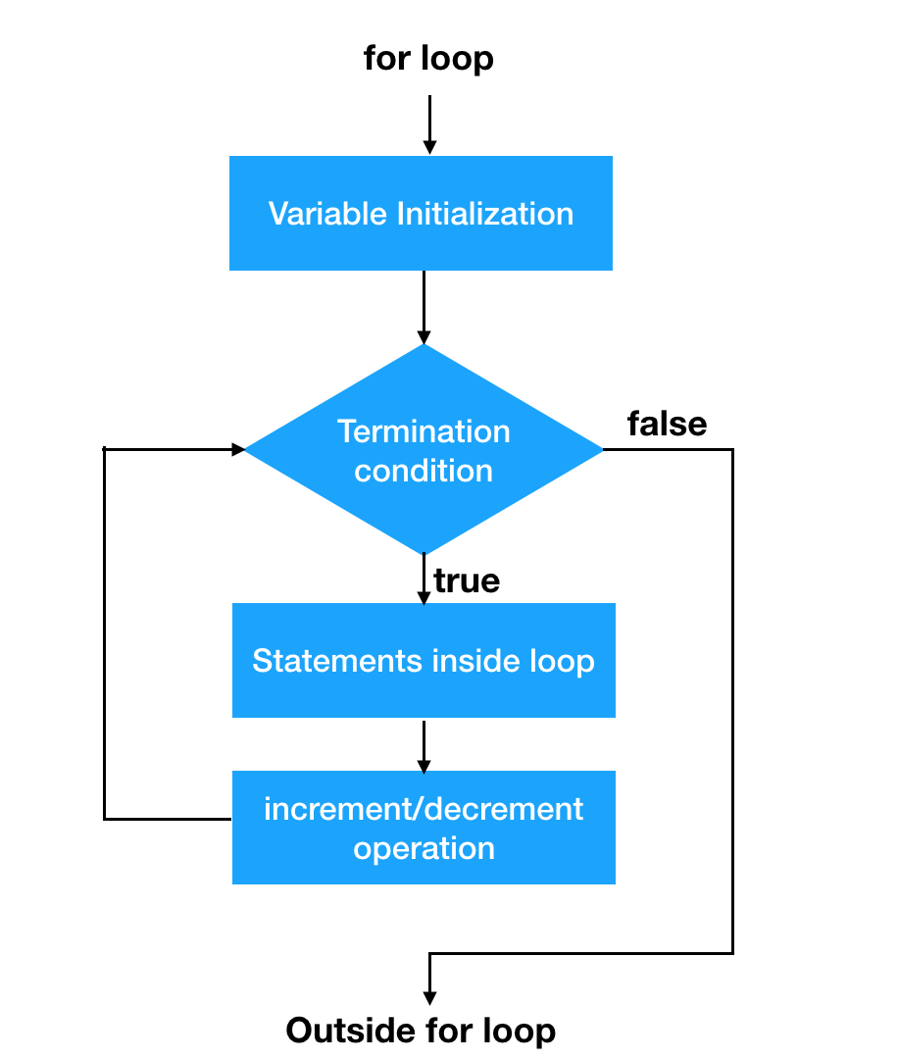
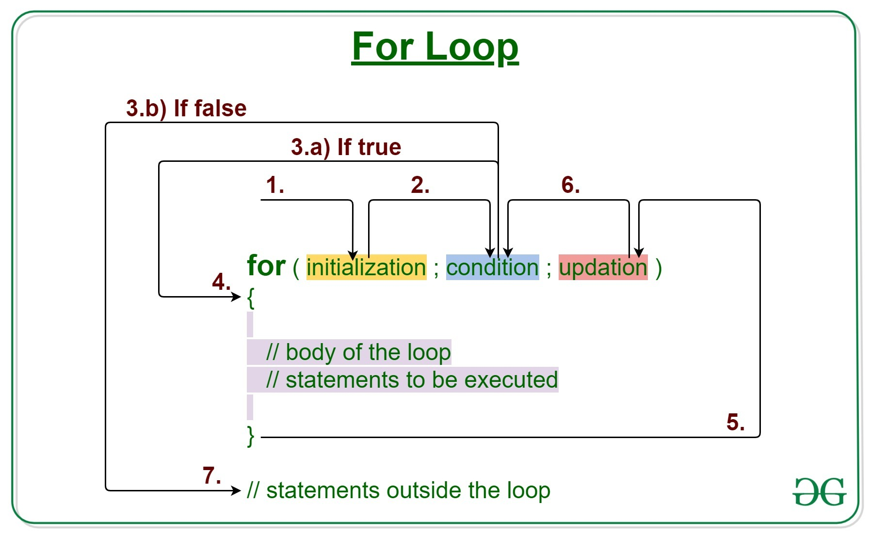
For loop

Slide 6
Range based for loop
In C++11, a new range-based for loop was introduced to work with collections such as arrays and vectors. Its syntax is:
for (variable : collection) { // body of loop }

Slide 7
Example
#include <iostream>
using namespace std;
int main() {
int num_array[] = {1, 2, 3, 4, 5, 6, 7, 8, 9, 10};
for (int n : num_array) {
cout << n << " ";
}
return 0;
}

Slide 8
C++ Infinite for loop
If the condition in a for loop is always true, it runs forever (until memory is full). For example,
// infinite for loop
for(int i = 1; i > 0; i++)
{
// block of code
}

Slide 9
Infinite while loop
If the condition of a loop is always true, the loop runs for infinite times (until the memory is full). For example,
// infinite while loop
while(true)
{ // body of the loop }

Slide 10
Infinite do while loop
int count = 1;
do { // body of loop }
while(count == 1);

Slide 11
When to use which looping statement?
A for loop is usually used when the number of iterations is known.
However, while and do...while loops are usually used when the number of iterations is unknown.

Slide 12
Which of the following two code segments is faster? Assume that compiler makes no optimizations.
/* FIRST */
for(i = 0; i < 10; i++)
for(j = 0; j < 100; j++)
//do something
/* SECOND */
for(i=0;i<100;i++)
for(j=0;j<10;j++)
//do something

Slide 13
Explanation
The SECOND executes assignment operations ( j = 0 or i = 0) 101 times while FIRST executes only 11 times.
The SECOND does 101 + 1100 comparisons (i < 100 or j < 10) while the FIRST does 11 + 1010 comparisons (i < 10 or j < 100).
The SECOND executes 1100 increment operations (i++ or j++) while the FIRST executes 1010 increment operation.

Slide 14
Complete the code to get the desired output
#include <iostream>
using namespace std;
int main() {
int n ;
for (n = 5; n < 0; n--)
{
cout << n;
}
return 0;
}
Desired Output: 543

Slide 15
Solution
#include <iostream>
using namespace std;
int main() {
int n ;
for (n = 5; n < 0; n--)
{
cout << n;
if (n == 3)
break;
}
return 0;
}

Slide 16
Debug the code
#include <iostream>
using namespace std;
int main() {
int a = 10;
if (a = 15)
{
time;
cout << a;
if (n == 3)
goto time;
}
break;
return 0;
}

Slide 17
Solution
Compile time error: the break statement need to be presented inside a loop or a switch statement.

Slide 18
Predict the output
#include <iostream>
using namespace std;
int main()
{
int n = 15;
for (; ;)
cout << n;
return 0;
}

Slide 19
Solution
There is not a condition in the for loop, So it will loop continuously.

Slide 20
Predict the output
#include <iostream>
using namespace std;
int main() {
int i ;
for (i = 0; i <= 10; i++);
{
cout << i;
}
return 0;
}

Slide 21
Solution
11

Slide 22
Hands on exercise

Slide 23
Problem statement 1
There are two banks – Bank A and Bank B. Their interest rates vary. You have received offers from both banks in terms of the annual rate of interest, tenure, and variations of the rate of interest over the entire tenure.You have to choose the offer which costs you least interest and reject the other. Do the computation and make a wise choice.
The loan repayment happens at a monthly frequency and Equated Monthly Installment (EMI) is calculated using the formula given below :
EMI = loanAmount * monthlyInterestRate / ( 1 – 1 / (1 + monthlyInterestRate)^(numberOfYears * 12))

Slide 24
Cont…
Constraints:
1 <= P <= 1000000
1 <=T <= 50
1<= N1 <= 30
1<= N2 <= 30
Input Format:
First line: P principal (Loan Amount)
Second line: T Total Tenure (in years).
Third Line: N1 is the number of slabs of interest rates for a given period by Bank A. First slab starts from the first year and the second slab starts from the end of the first slab and so on.
Next N1 line will contain the interest rate and their period.
After N1 lines we will receive N2 viz. the number of slabs offered by the second bank.
Next N2 lines are the number of slabs of interest rates for a given period by Bank B. The first slab starts from the first year and the second slab starts from the end of the first slab and so on.
The period and rate will be delimited by single white space

Slide 25
Solution
#include <iostream>
#include <math.h>
using namespace std;
int main()
{
double p,s,mi,sum,emi,bank[5],sq;
int y,n,k,i,yrs,l=0;
cin>>p;
cin>>y;
for(k=0;k<2;k++) { cin>>n;
sum=0;
for(i=0;i<n;i++) { cin>>yrs;
cin>>s;
mi=0;
sq=pow((1+s),yrs*12);
emi= (p*(s))/(1-1/sq);
sum= sum + emi;
}

Slide 26
Staircase problem
There are n stairs, a person standing at the bottom wants to reach the top. The person can climb either 1 stair or 2 stairs at a time.
Count the number of ways, the person can reach the top.

Slide 27
Solution
#include <iostream>
using namespace std;
int calc(int n);
int count(int x);
int main ()
{
int n ;
cout<<("Enter number of stairs : ");
cin>>n;
cout<<("Number of ways = %d", count(n));
return 0;
}
int count(int x)
{
return calc(x + 1);
}
int calc(int n)
{
if (n <= 1)
return n;
return calc(n-1) + calc(n-2);
}

Slide 28
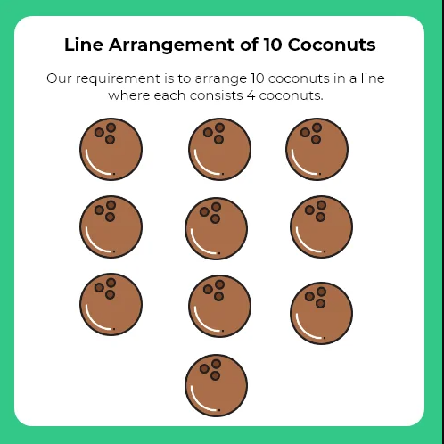
Brain Booster
Arrangement of 10 Coconuts in a Line
Aman is given a task to arrange 10 coconuts in a particular structure. The premise, rule and objective for the Arrangement of 10 coconuts is given below. Read them properly and find the solution for the same.
Premise – The task is to arrange coconuts as a Line.
Rule – Each line contains 4 coconuts.
Objective – To arrange the coconuts in 5 lines such that each line contains 4 coconuts.
Asked in Accenture interview : software developer

Slide 29
Solution
Draw a star with pentagon in the middle of it.
Now arrange coconuts on the intersection points of the two lines.
This way we have arranged first five coconuts.
Now, put each coconut on the vertices of the star or the extended vertices of a pentagon.
Now, all the 10 coconuts are arranged in the form of lines.
Now if you see any line, each line consists 4 coconuts.

Slide 30
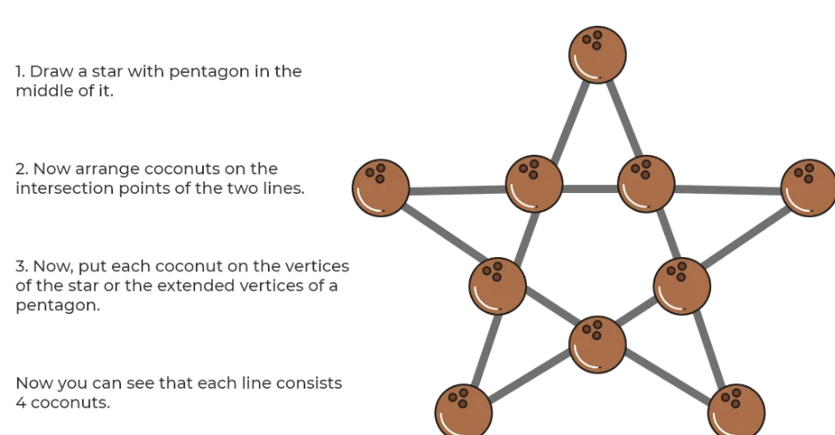
Solution

Slide 31
Pattern programs using loops
16 Basic Patterns Programs in C++ - Dev C++Tutorials (cpphinditutorials.com)

Slide 32
Thanks.

